Slide 1
















BistroBill
A Billing Application
Submitted By: Utkarsh Patel
Registration Number: 12307357
Roll Number: 40
Institution: Lovely Professional University

Slide 2

INTRODUCTION:
Billing management is a critical aspect of modern business operations, often hindered by manual processes and fragmented tools.
BistroBill is a Python-based GUI application that offers:
Comprehensive billing and invoicing solutions in one platform.
Seamless management of item inventories, customer records, and financial transactions.
Integrated utilities, including a currency converter, notepad, and calculator.
Goal: To simplify and enhance billing workflows, ensuring accuracy, efficiency, and scalability for businesses.
.

Slide 3


OBJECTIVES:
BistroBill aims to:
Provide an all-in-one platform for managing billing, invoicing, and customer records.
Offer seamless integration of item inventory, billing, and utility tools for streamlined operations.
Facilitate accurate and efficient financial workflows with built-in calculators and tax management.
Enable quick and real-time currency conversions to support international transactions.
Enhance user experience through an intuitive, visually appealing, and user-friendly interface.

Slide 4

SCOPE:
The application includes:
Main Interface: A centralized hub connecting all modules for easy navigation.
Billing Module: A streamlined system for managing orders, calculating totals, and generating invoices.
Item Inventory Module: Tools for adding, updating, and tracking menu items with real-time integration.
Utilities: Integrated notepad, calculator, and currency converter for enhanced functionality.
Data Management: JSON-based storage for seamless record-keeping and quick data retrieval.
Outcome: An efficient, user-friendly platform that simplifies billing management and enhances business operations.

Slide 5

APPLICATION TOOLS:
Programming Language: Python for flexibility and scalability.
IDE: PyCharm for efficient development and debugging.
Libraries Used:
Tkinter: GUI design.
CustomTkinter: Modern themes and styles.
Pillow: Image processing.
Datetime: Handling travel schedules.
JSON: Lightweight data storage
Requests: Facilitates API integration for features such as SMS and currency exchange.
Data Storage: JSON for simple, efficient storage of menu items and billing data.
Version Control: Git for systematic project tracking.

Slide 6
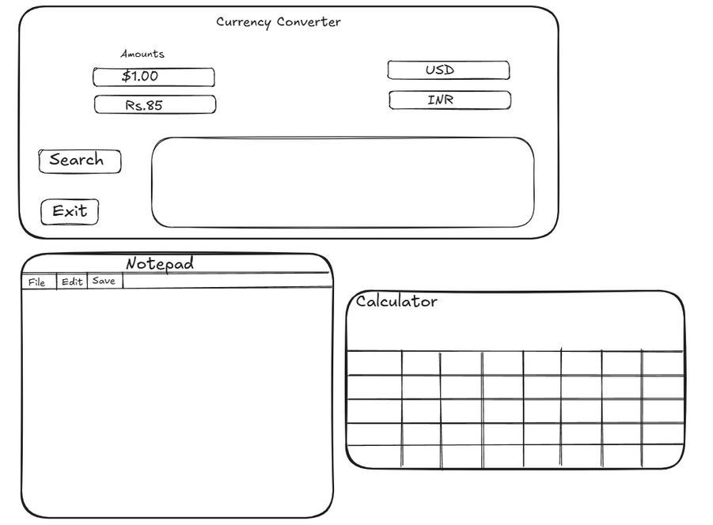
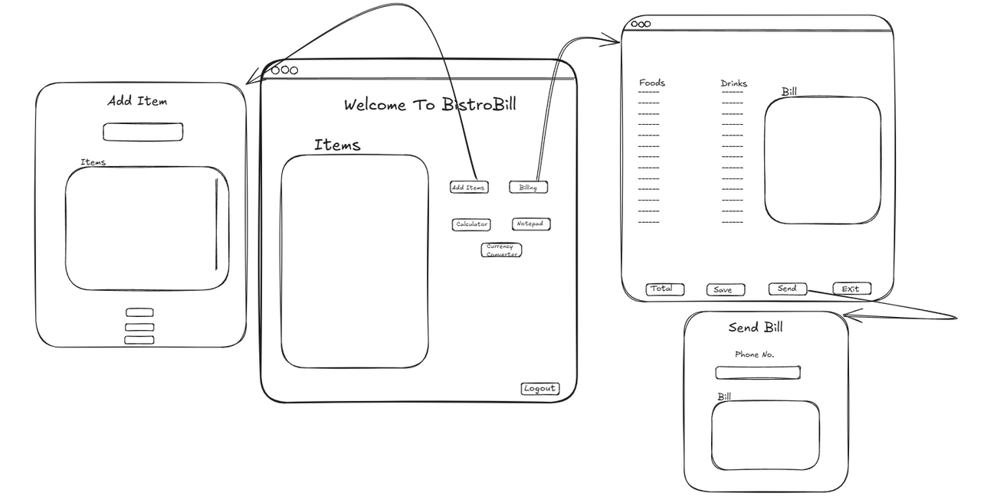
BLUEPRINT

Slide 7
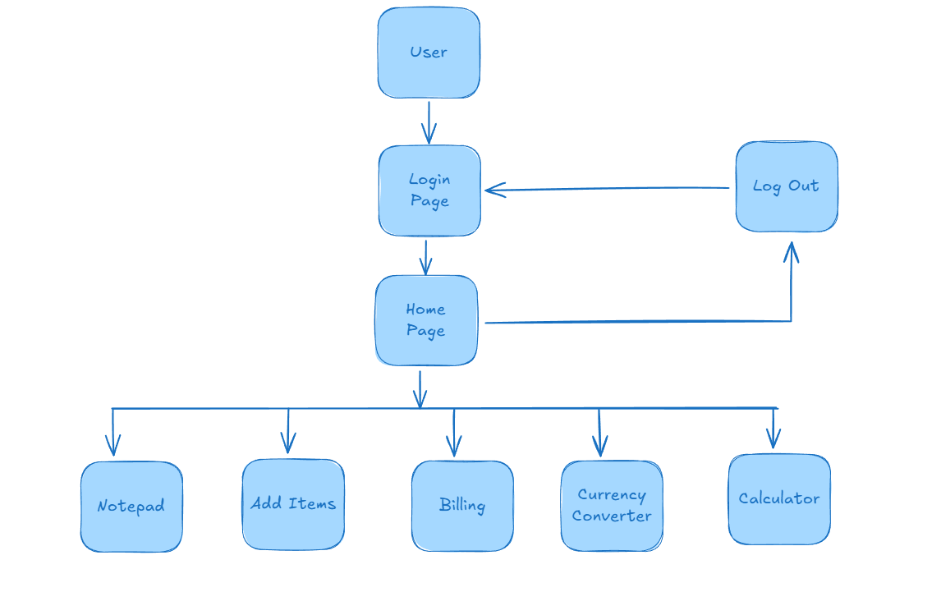
Level 0 DFD

Slide 8
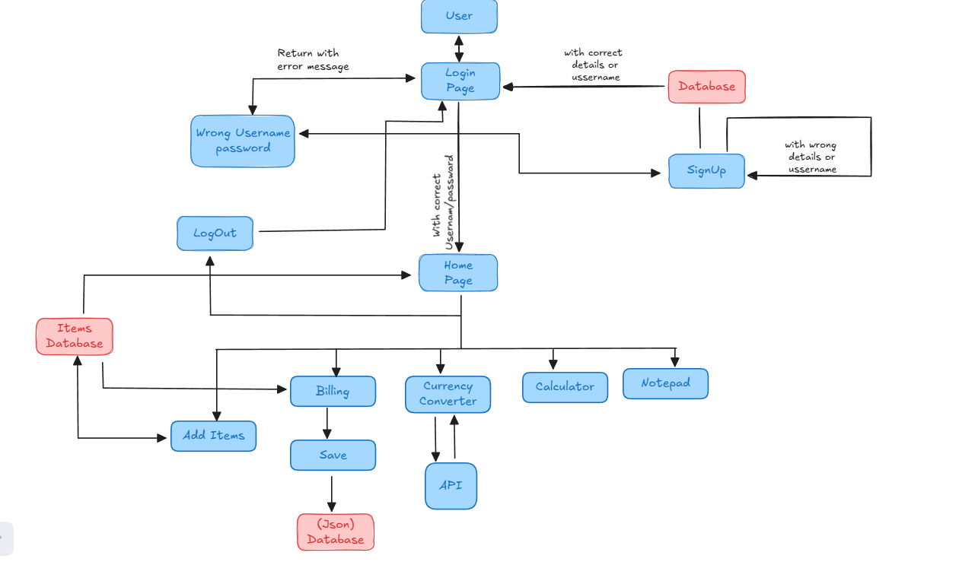
Level 1 DFD

Slide 9





SCREENSHOTS

Slide 10
CONCLUSION
Achievements:
Developed a unified platform for comprehensive billing management.
Simplified financial workflows through integrated modules and utilities.
Delivered a responsive, user-friendly design that enhances productivity and user experience.
Future Enhancements:
Transition to a secure database for improved data handling and scalability.
Integration of advanced features like cloud synchronization and multi-device support.
Implementation of enhanced security measures and user access control.
Addition of detailed analytics and reporting tools for business insights.

Slide 11
THANK YOU VERY MUCH!

